Slide 1

TARGET FOLDER
SRNTGT103
Murmashi Bomb Factory, SRN
SECRET - DCS WORLD
REL TO COALITION
SECRET - DCS WORLD
REL TO COALITION

Slide 2


BE: SRNTGT101 CATCODE: 54
MIDB GEO: N 69 03.636 E 033 26.451
ICOD: 05JAN2024 DOI:05JAN2024
Murmashi Bomb Factory, SRN
OPAC CLASSIFIED REL TO CJTF-23
JOINT OPERATIONS GRAPHIC 1/1
MAP
OVERVIEW
BE: SRNTGT103 CATCODE: 9
MIDB GEO: N 68 48.603 E 032 46.608
ICOD: 2011-JUL-06 DOI:2011-JUL-06
DECL ON: 2061-JUL-06
N
Murmashi Bomb Factory SRNTGT103
.

Slide 3
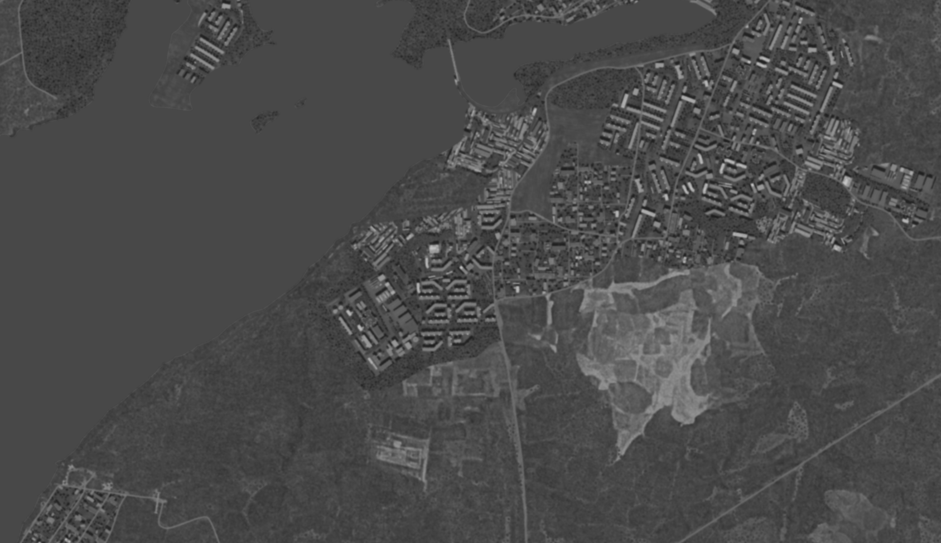
BE: SRNTGT101 CATCODE: 54
MIDB GEO: N 69 03.636 E 033 26.451
ICOD: 05JAN2024 DOI:05JAN2024
Murmashi Bomb Factory, SRN
OPAC CLASSIFIED REL TO CJTF-23
FACILITY OUTLINE GRAPHIC 1/1
MAP
OVERVIEW
BE: SRNTGT103 CATCODE: 9
MIDB GEO: N 68 48.603 E 032 46.608
ICOD: 2011-JUL-06 DOI:2011-JUL-06
DECL ON: 2061-JUL-06
N
Murmashi Bomb Factory SRNTGT103

Slide 4
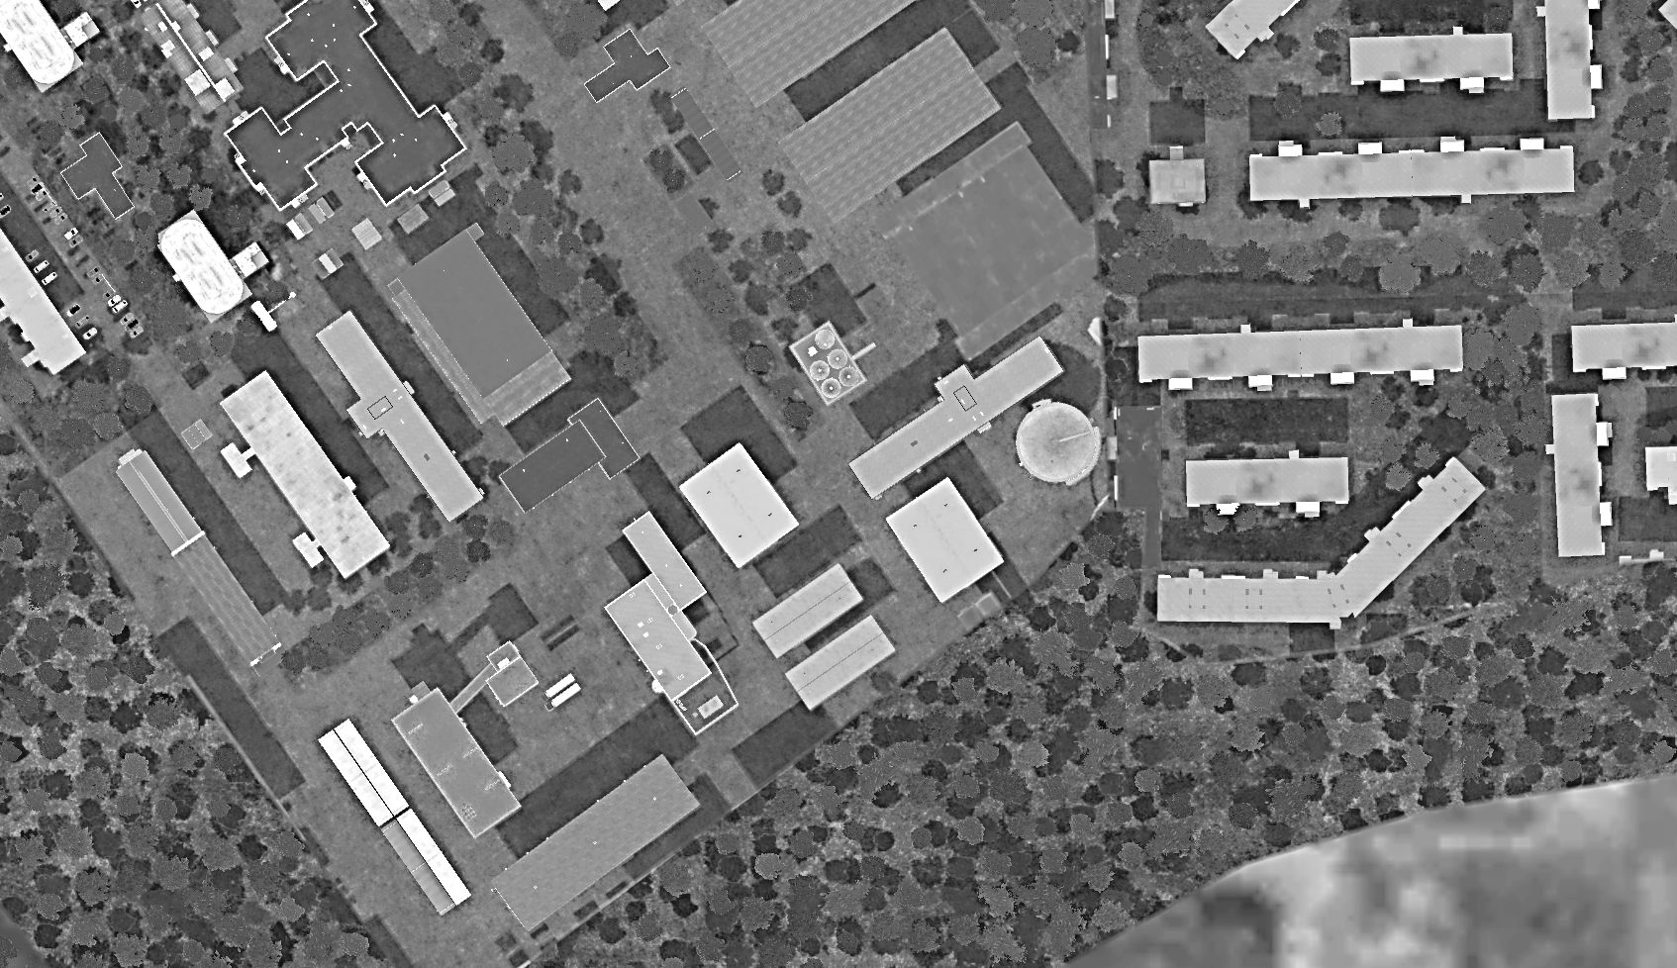
BE: SRNTGT101 CATCODE: 54
MIDB GEO: N 69 03.636 E 033 26.451
ICOD: 05JAN2024 DOI:05JAN2024
Murmashi Bomb Factory, SRN
OPAC CLASSIFIED REL TO CJTF-23
DESIRED POINT OF IMPACT GRAPHIC 1/1
MAP
OVERVIEW
BE: SRNTGT103 CATCODE: 9
MIDB GEO: N 68 48.603 E 032 46.608
ICOD: 2011-JUL-06 DOI:2011-JUL-06
DECL ON: 2061-JUL-06
N
DPI: C
CHEMICAL STORAGE
N 68 48.621 E 032 46.591 DPI MSL: 188 FT
DPI: D
CHEMICAL STORAGE SILO
N 68 48.601 E 032 46.687 DPI MSL: 193 FT
DPI: A
BOMB PRODUCTION ON GRN
N 68 48.589 E 032 46.628 DPI MSL: 188 FT
DPI: B
BOMB PRODUCTION ON GRN
N 68 48.601 E 032 46.539 DPI MSL: 191 FT

Slide 5
BE: SRNTGT101 CATCODE: 54
MIDB GEO: N 69 03.636 E 033 26.451
ICOD: 05JAN2024 DOI:05JAN2024
Murmashi Bomb Factory, SRN
OPAC CLASSIFIED REL TO CJTF-23
WEAPONEERING OPTIONS 1/1
MAP
OVERVIEW
BE: SRNTGT103 CATCODE: 9
MIDB GEO: N 68 48.603 E 032 46.608
ICOD: 2011-JUL-06 DOI:2011-JUL-06
DECL ON: 2061-JUL-06
JDPI | DESCRIPTION | TLE | WARHEAD | GUIDANCE | DESIRED EFFECT | IMPACT ANGLE | FUZING
A | MISSILE PRODUCTION PLANT 1 | CAT 2 | 1000 lbs | DECIMETRIC | BLAST, FRAGMENTATION | 60-90 | 25ms
B | MISSILE PRODUCTION PLANT 2 | CAT 2 | 1000 lbs | DECIMETRIC | BLAST, FRAGMENTATION | 60-90 | 25ms
C | CHEMICAL STORAGE | CAT 2 | 1000 lbs | METRIC | BLAST, FRAGMENTATION | 60-90 | 25ms
D | CHEMICAL STORAGE | CAT 2 | 1000 lbs | METRIC | BLAST, FRAGMENTATION | 60-90 | 25ms

Slide 6
BE: SRNTGT101 CATCODE: 54
MIDB GEO: N 69 03.636 E 033 26.451
ICOD: 05JAN2024 DOI:05JAN2024
Murmashi Bomb Factory, SRN
OPAC CLASSIFIED REL TO CJTF-23
COLLATERAL DAMAGE ESTIMATION GRAPHIC [X]
MAP
OVERVIEW
BE: SRNTGT103 CATCODE: 9
MIDB GEO: N 68 48.603 E 032 46.608
ICOD: 2011-JUL-06 DOI:2011-JUL-06
DECL ON: 2061-JUL-06
400ft
N
DPI D
DPI A
NCC: INDUSTRIAL UNITS
100FT W FROM DPI A
NCC: RESIDENTIAL UNITS
100FT W FROM DPI D
CDE 5

Slide 7
BE: SRNTGT101 CATCODE: 54
MIDB GEO: N 69 03.636 E 033 26.451
ICOD: 05JAN2024 DOI:05JAN2024
Murmashi Bomb Factory, SRN
OPAC CLASSIFIED REL TO CJTF-23
COLLATERAL DAMAGES ESTIMATION 1/1
MAP
OVERVIEW
BE: SRNTGT103 CATCODE: 9
MIDB GEO: N 68 48.603 E 032 46.608
ICOD: 2011-JUL-06 DOI:2011-JUL-06
DECL ON: 2061-JUL-06
COLLATERAL DAMAGES WITHIN A 500M RADIUS
DESCRIPTION |  | CATCODE | MIDB GEOS | LOCATION | REMARKS
Industrial Units |  | 13 |  | 100ft SW of DPI A | Civilian Industrial Units, will incur causalities
Residential Units |  | 14 |  | 800ft W of DPI B,C | Civilian Residential Units, will incur causalities
NO STRIKE ENTITIES WITHIN A 500M RADIUS
NSE ID | DESCRIPTION | CATCODE | MIDB GEOS | LOCATION | REMARKS

Slide 8
BE: SRNTGT101 CATCODE: 54
MIDB GEO: N 69 03.636 E 033 26.451
ICOD: 05JAN2024 DOI:05JAN2024
Murmashi Bomb Factory, SRN
OPAC CLASSIFIED REL TO CJTF-23
BATTLE DAMAGE ASSESSMENT GRAPHIC 1
MAP
OVERVIEW
BE: SRNTGT103 CATCODE: 9
MIDB GEO: N 68 48.603 E 032 46.608
ICOD: 2011-JUL-06 DOI:2011-JUL-06
DECL ON: 2061-JUL-06
POST-STRIKE
PRE-STRIKE
N
TARGET OBJECTIVE
DAMAGE/CHANGE ASSESSMENT
JDPI:[XXXXXX]
BDA REMARK: [CLASSIFICATION] [DISSEMINATION] Assessment: Physical Damage/change, Collateral Damage, Functional Damage/change, Munitions Effectiveness, Reattack Recommendation, Additional/Collateral Effects

Slide 9
ACRONYMS
ACRONYM | MEANING | DEFINITION
BE | Basic Encyclopedia Number | Alpha/numeric code unique to an installation for incorporation within various national and tactical systems.
CATCODE | Category Code | The data Element that classifies the function and purpose of an installation or a facility.
MIDB | Modernized Integrated Database | A database comprised of information on facilities of military significance, military forces, and related equipment.
ICOD | Intelligence Cut Off Date | The date of the latest intelligence data inputted to a feature.
DOI | Date of Image | Date on which a geospatial or intelligence-related image was captured.
CE | Critical Element | An element of an entity or object that enables it to perform its primary function.
JDPI | Joint Desired Point of Impact | A unique, alphanumeric coded aimpoint identified by a three dimensional mensurated point. It represents a weapon or capability desired point of impact or penetration.
CE90 | Circular Error at 90% | 90 percent confidence level in the horizontal plane.
LE90 | Linear Error at 90% | 90 percent confidence level in the vertical dimension
MSL | Mean Sea Level | Elevation above Earth reference geoid.
AGL | Above Ground Level | Elevation above ground surface.
NCC | Nearest Collateral Concern | Closest non-targeted structure, area, or entity near a planned point of impact that may be at risk of unintended damage during a military strike.
CER | Collateral effects radius | Radius within which collateral damage might happen based on the weapon's characteristics, the target environment, and other operational factors.
CDE | Collateral damage estimate | Systematic process used in military targeting to evaluate the potential for unintended damage or harm to non-combatant entities, structures, or personnel as a result of a planned strike.
NSE | No Strike Element | Specific entities, locations, or objects that are protected from intentional targeting under the Law of Armed Conflict (LOAC) or by operational policy.

